Slide 1
Process Composition:
Quality of Service Specification
Semantics, and Adaptation
EI3-IC Workshop 3
Gaithersburg MD, February 6-8 2002
Jorge Cardoso and Amit Sheth
Large Scale Distributed Information Systems (LSDIS) Lab,
Department of Computer Science
University of Georgia, Athens, GA 30602 - USA
http://lsdis.cs.uga.edu/~amit

Slide 2
Workflows
Workflows are an abstraction of business processes.
A workflow normally comprises a number of logical steps, which are known as tasks, dependencies between tasks, routing rules, and participants.
A Workflow system reads, automates, processes, and manages workflows by coordinating the sharing and routing of information.

Slide 3
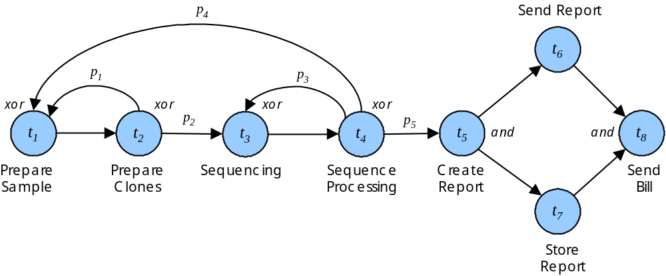
Workflow Example

Slide 4
Web Services
The importance of Web services has been recognize by the academia and by commercial organizations.
Several efforts are being carried to develop a specification language for Web services.
Approaches include XLANG [XLANG, 01], WSLF [WSLF, 01], and DAML-S [DAML-S, 01].

Slide 5
Web Services and Workflows
Web service composition can be represented using workflows
Of specific interest is cross-organizational workflow (workflows that span across organizations)

Slide 6
Problem Statement
In e-commerce processes, suppliers and customers define a binding agreement or contract between the two parties, specifying quality of service (QoS) items such as products or services to be delivered, deadlines, quality of products, and cost of service. Management of QoS directly impacts success of organizations participating in e-commerce.

Slide 7
Quality of service
Quality of service management is indispensable for organizations striving to achieve a higher degree of competitiveness.
Processes executed under the control of a enactment systems can be characterized and quantified according to various dimensions.
We call the set of dimensions associated with quality of service workflow quality of service (QoS).
The computation of QoS metrics allow organizations to better align their vision and operational processes.

Slide 8
Research issues
Specification. What dimensions need to be part of the Quality of Service for workflows?
Computation. What methods and algorithms can be used to predict QoS?
Monitoring. What king of wQoS monitoring tools need to be developed?
Control. What mechanisms need to be developed to control workflow processes, in response to unsatisfactory QoS metrics?
Notes:
We need to refer to this paper and provide comparison of our strategy with rudimentary specification they have provided. Essentially we need to extend theirs.
http://www.semanticweb.org/SWWS/program/full/paper57.pdf
They do not have things other than specification yet…
(separate note: I think we should go ahead and show how these can be done before they do. But we should use DAML and DAML-S syntax where possible.)
Make sure we also reference http://www.ai.sri.com/daml/notes/HW2/paper.pdf

Slide 9
QoS Model Requirements
The quality dimensions represented in the QoS model needs to be computable
There must exist a QoS function at each node of the process tree that can be applied to its children.
From this observation we developed a QoS model for which all its dimensions are computable.

Slide 10
QoS Model
QoS describes non-functional properties of a workflow. It is an important complement to the operational description of workflows.
The QoS model is composed with four dimensions
  Time
    Time associated with the execution of a task or workflow.
  Cost
    Cost associated with the execution of a task or of a workflow.
  Reliability
    The probability of a task or workflow to succeed.
  Fidelity
    The accuracy of task’s operations
QoS
Notes:
Again point out what DAML-S has now and what you have extra
[Jorge] DAML-S specifies the structure of a workflow. It is an operational description. wQoS describe non-functional issues of a workflow.
give one example for each of the above 4 items

Slide 11
QoS - Time
Time is a common and universal measure of performance.
For workflow systems, it can be characterize defined as the total time needed by an instance to transform a set of inputs into outputs.
The first measure of time is task cycle time (T_{CT}).
The task cycle time can be breakdown in two major components: delay time and process time.
T_{CT}(t) = T_{DT}(t) + T_{PT}(t)
Notes:
Again point out what DAML-S has now and what you have extra
[Jorge] DAML-S specifies the structure of a workflow. It is an operational description. wQoS describe non-functional issues of a workflow.
give one example for each of the above 4 items

Slide 12
QoS - Cost
Task cost represents the cost associated with the execution of workflow tasks.
Cost is an important factor, since organizations need to operate according to their financial plan.
Task cost (TC) can be broken down in into two major components: processing enactment cost and task realization cost.
  TC(t) = TEC(t) + TRC(t)
Notes:
Again point out what DAML-S has now and what you have extra
[Jorge] DAML-S specifies the structure of a workflow. It is an operational description. wQoS describe non-functional issues of a workflow.
give one example for each of the above 4 items

Slide 13
QoS - Reliability
Task Reliability (T_{R}) corresponds to the likelihood that the components will perform for its users when the user demands it and it is a function of failure rate.
This dimension follows from one of the popular discrete-time stable reliability model proposed in [Nelson, 73].
  TR(t) = 1 - failure rate
Notes:
Again point out what DAML-S has now and what you have extra
[Jorge] DAML-S specifies the structure of a workflow. It is an operational description. wQoS describe non-functional issues of a workflow.
give one example for each of the above 4 items

Slide 14
QoS - Fidelity
Fidelity is a function of effective design and refer to an intrinsic property or characteristic of a good produced or service rendered.
Workflow tasks have a fidelity (T_{F}) vector dimension composed by a set of fidelity attributes (T_{F(t).ai}), to reflect and quantify tasks operations.
Depending on the task type different strategies are used to set fidelity attributes.
Notes:
Again point out what DAML-S has now and what you have extra
[Jorge] DAML-S specifies the structure of a workflow. It is an operational description. wQoS describe non-functional issues of a workflow.
give one example for each of the above 4 items

Slide 15
Computing QoS
Workflow w
N1
A
B
N2
C
D
N3
E
F
N4
f_qos(x₁,..,x_{n})
G
H
I
J
k
L

Slide 16
References
[DAML-S] http://www.daml.org
[WSFL,01] http://www-4.ibm.com/software/solutions/webservices/pdf/WSFL.pdf
[XLANG, 01] http://www.gotdotnet.com/team/xml_wsspecs/xlang-c/default.htm
[Nelson, 73] E. C. Nelson, “A Statistical Basis for Software Reliability”, TRW Software Series, TRW-SS-73-02, March 1973.

Slide 17
Computer Aided Workflow Design based on Semantics and QoS specifications.
Dynamic Workflow Adaptation.
Notes:
May be it should be: based on Semantics and QoS specifications [Check]

Slide 18
Computer-Aided Design based on Semantics
Designing cross-organizational workflows is a complex process.
Different components (tasks) from different organizations need to be coupled together.
It is important for users to be aided during the design process.
The system can help users, with the provision of task semantic fitness indicators.
Design time validation
Notes:
What about distribution of ontologies and partially defined workflow specs?
[Jorge] I Do not understand
As part of the last item, how about design time validation? [Jorge] check

Slide 19
Research issues
Specification. How semantics can increase workflow tasks specification richness to facilitate and automate workflow process design.
Selection/Reuse. How can tasks be searched, ranked and selected from repositories based on syntactic and semantic match.
Composition. How semantics can facilitate the resolution of data and schematic conflicts among tasks.
Notes:
Let us discuss what semantics adds to specification. It adds common terminology, so that you can have common understanding. We should propose use of semantics for two things: functional specification and QoS specification. For latter, what we want to do is to provide a QoS ontology, which allows common understanding of QoS specification. There could be multiple QoS onologies if such a flexibility is needed.
Selection -> Selection/reuse

Slide 20
Solution Outline
Specification. Each workflow task is associated with ontologies, describing the task functionality, interface, and QoS.
Selection. The tasks selected to design a workflow are ranked based on a semantic and syntactic fitness function.
Composition. During workflow composition wQoS metrics are computed to allow the user to control workflow quality of service.
Notes:
A task needs to be associated with possibly more than one onologies-- usually at least two-- one for functional specification another for QoS specification.
For composition-- we have to look at both functional aspects (e.g., what DAML-S paper talks about, and this includes input/output matches) and QoS aspect of composition (e.g., disallow compositions that would lead to
[Jorge] input/output matches and QoS analysis is done at the selection phase

Slide 21
Solution outline
Repository
Ontology
A
Semantic Fitness
t_{d}
Ontology
A
0.99
Sequence
Processing
Machine A
Ontology
B
t_{c}
0.34
p_{bc}
t_{e}
t_{α}
p_{αb}
t_{b}
Sequencing
Method A
Send report
*
0.74
p_{be}
Prepare
Sample
Prepare
Clones
t_{e}
t_{f}
Sequencing
Method B
Sequence
Processing
Machine B
Ontology
A

Slide 22
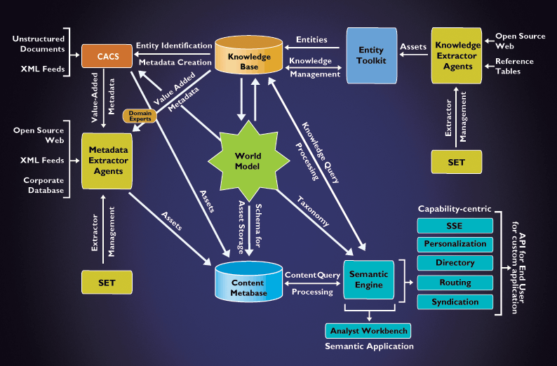
SCORE Semantic Technology System Architecture
Fast main-memory based query
engine with APIs and XML output
Distributed agents that automatically extract/mine
knowledge from trusted sources
Toolkit to design and maintain the Knowledgebase
Distributed agents that automatically extract relevant
semantic metadata from structured and unstructured content
Knowledgebase represents the real-world instantiation
(entities and relationships) of the WorldModel
CACS provides automatic classification (w.r.t. WorldModel)
from unstructured text and extracts contextually relevant metadata
WorldModel specifies enterprise’s
normalized view of information (ontology)
Http://www.voquette.com/demo

Slide 23
Workflow Adaptation
In modern economies and organizations, business processes change has become a constant.
There is a constant need for continuous workflow design improvement.

Slide 24
Research issues
Detection. When should workflows be dynamically adapted?
Change Analysis. When adaptation is required how can alternative be generated?
Change Introduction. When can adaptation be made to currently running workflows without violating its consistency and other constraints?

Slide 25
Solution Outline
Detection. Workflows are dynamically adapted when their wQoS metrics are not satisfactory.
Change Analysis. Adaptation alternatives are generated based on adaptation patterns.
Change Introduction. Adaptation is made to currently running workflows through the use of a dynamic change layer to guarantee consistency of workflows after changes.
Notes:
Minor change in first bullet [check]

Slide 26
Workflow Adaptation
Dynamically and automatically change a workflow to meet wQoS requirements
  Non-structural Adaptation
    Replace a task with an alternative task with attributes that will permit a workflow to exhibit satisfactory wQoS
  Structural Adaptation
    Load distribution pattern
      Decrease Time, Increase Cost
    Redundant pattern
      Increase Fidelity, Increase Cost
    More patterns …

Slide 27
Examples of Structural changes (1)
Load distribution pattern
Cost and Speed
Probability = 40%
B₁
a
B
z
a
z
+
+
Probability = 60%
B₂
Notes:
Why are we not concered with concurrency problems? The workshlow semantics (here that of task 2) should allow such a concurrent execution for better output. Eg. A human task performed by persons with the given role will meet this criteria.
[Jorge] [I do not understand]

Slide 28
Examples of Structural changes (2)
Redundancy pattern
Cost and Fidelity
B₁
a
B
z
a
*
B₂
*
V
z
B₃
Voting task
Notes:
See note on concurrency in previous slide

Slide 29
Putting all together
Semantic
Design
Workflow QoS
Specifications
Workflow QoS
Analysis
Workflow
Adaptation
Adaptive WfMS behavior
For more information: http://lsdis.cs.uga.edu/proj/meteor/meteor.html

